Slide 1

Building Leadership Capacity
Embracing Change
New Reality Leadership
Copyright 2010-2018 New Reality Leadership, LLC.
January 2020
Notes:
Slide Intent
Cover slide

Slide 2

Rapid Rate of Change
  List changes you have experienced in the last 5-10 years.
Notes:
Slide Intent
Get the group to think about the rapid and even exponential pace of change.
Key Messages
As a large group to share changes from the last 5-10 years and chart them.
There are a variety of videos showing rapid change that you could use in this segment.
Ask participants to think about the implications and that you will discuss shortly.
Facilitation Notes
If companies continue to run their businesses as in the past, they may be left behind. Leaders need to develop all employees and engage them for their performance, creativity, and innovation. Employees need to step up and be learners. They need to embrace the changes that are going on and maximize the potential benefits from the changes vs. being resistant to them.

Slide 3

Objectives
Discover how to proactively embrace and take charge of change
Maximize the personal value of change
Assess your approach to change
Apply practical steps to navigate through change
Notes:
Slide Intent
Introduce Objectives
Key Messages
Highlight and quickly discuss these objectives.
Hang either a poster of this chart or a hand written chart on the wall for review.
Facilitation Notes

Slide 4

Agenda
  The Case for Embracing Change
  The Change Curve
  The Competency Connection
  Assessing your Approach to Change
  Personal Application
  Summary
Notes:
Slide Intent
Introduce Agenda.
Key Messages
These topics are the flow of this module.
Facilitation Notes
Adjust agenda as needed based on your focus.
.

Slide 5

Ultimate Role of the Leader:
Maximizing Performance by Leading through change effectively
Employee Role
Full Potential
Potential
Gap
Current Performance
Notes:
Slide Intent
Provide a pictorial view of closing the performance gap, or….better said, maximizing the performance of the employee.
Key Discussion Points
To keep up with change and lead change effectively, employees will have to be developed and engaged in accelerated ways.
We will not be able to leisurely let employees develop but be methodical in our approach
Facilitation Notes
It is helpful to have some of the core charts hung permanently and referred to often. All content helps leaders close this performance gap.

Slide 6

The Need for Change
Shenzhen, 1980
Population 30,000
Notes:
6
Slide Intent
Build the case for change.
Key Messages
Show the next several slides to highlight the rapid changes taking place in the world around us.
In 1979, Shenzhen (then a series of sleepy fishing villages among the estuaries facing Hong Kong) was designated the first of China's Special Economic Zones (SEZ). The plan was to create a sealed off enclave to experiment with market reforms and performance incentives without posing a threat or risk to the established economic system elsewhere in China. Shenzhen won the honor as it could easily connect to the capital and management resources of Hong Kong and serve as a buffer between a more open border with Hong Kong and the rest of mainland China. Currently it has a population of approximately 12 million, compared to only 30,000 in the 1980s.
Facilitation Notes
These slides build the urgency of why we need to approach our work places differently than in the past. Employees need to appreciate that we need to be creative, innovative, and work in new ways. These changes may impact our jobs. We may have to learn new skills or we may not be competitive in the job market and our companies may not survive.
.

Slide 7

The Need for Change
Shenzhen, 2018
Population 12,000,000
Notes:
As of 2018 Shenzhen has a population of approximately 12 million, compared to only 30,000 in the 1980s, and it’s still growing.
7

Slide 8
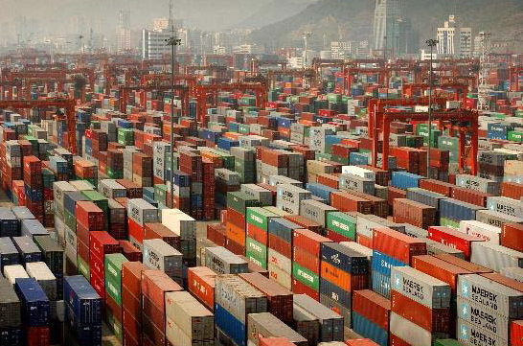
The Need for Change
Prior to 1980, Shenzhen had no exports
In 2018, 35 Million cargo containers are shipped from just Shenzhen each year.
Notes:
8
A port that didn’t exist 30 years ago now ships on average more than 100,000 containers each day or about one container per second. Those products were made in other countries and many of those companies are no longer in business.

Slide 9


Debrief: Did you Know and Shenzhen
Think about what we charted on the changes we listed and on the slides of Shenzhen. In your groups, discuss these questions:
  What strikes you most about these situations?
  What implications do you see based these changes? That is, what does your business need to consider going forward to be successful?
  What other thoughts do you have?
Notes:
Slide Intent
Debrief the list of changes and the Shenzhen pictures.
Key Messages
Break participants into small groups. Have them reflect on both list of changes and pictures and answer the questions on the slide.
You can also do this exercise as a large group depending on class and timing.
Facilitation Notes
As you facilitate, watch to see if the participants see the urgency for change and why our approach to work and life may need to be different in the future. If employees do not see the urgency for change, they will be resistant when corporate changes are made.

Slide 10

Dealing with Negative Personal Change
Think about a change that impacted you personally.
What was the initial negative impact for you?
What did you learn through the experience?
If it has been a while since the change, can you identify one or two positive outcomes or learnings that you see from this change?
Notes:
Slide Intent
Discuss negative change to find any positive outcomes.
Key Messages
Process as a large group or give individuals a few minutes to write some notes on a pad or in their workbook.
Ask for a couple of examples. Some may not want to share; be sensitive to the group needs.
Facilitation Notes
It is hard to find a positive outcome during a difficult change. Often after time, people can find a benefit or learning that has helped them by going through that difficult time.

Slide 12
2. The Change Curve
Goal is to make the transition through the change towards phase 3
Phase 3
Embracing Change
Phase 1
Discovering the Change
Applying the principles of this module helps you minimize the dip and maximize the benefits
Changes can be positive or negative
Commitment
Denial
Wonder
Contentment
Resolve
Excitement for some
Excitement
Resistance
Exploration
Fear
Anger
Stress
Lack of Trust
Skepticism
Anxiety
Confusion
There are several stages you experience during changes
Isolation
Phase 2
Managing the Challenges
Notes:
Slide Intent
Introduce the Change Curve.
Key Messages
Show chart and discuss the flow. These phases are generalities about how people process change. Employees approach change in different ways. Some people go with the flow while others are proactive and find ways to help. Others may be anxious or resistant.
The goal is to find ways to manage through the change and maximize the potential benefits.
Make a poster of this chart and hang. If the participants are open, have them think about a change your organization is going through now. Have them put a colored dot on the chart indicating where they are in processing the change for themselves. For example, if you are going through a restructuring, where would the participant see themselves on the curve right now?
Facilitation Notes
Read through the participant guide to understand this model before presenting. Some employees may not want to indicate where they are thinking it may indict them if they are still in phase one of a change. Be sensitive to the group to determine if the dot exercise is useful.
As you present, ensure you capture the implications noted in the participant guide. The slides have animated notes that help ensure you remember the points. You can edit these or add to these as needed.

Slide 13
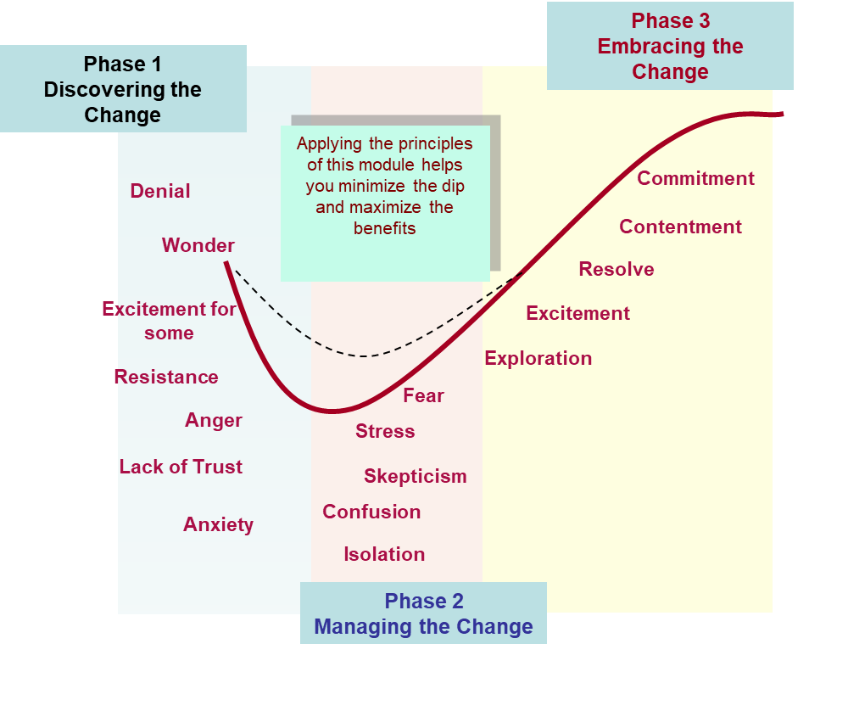
Getting Ahead of Change
On post its, write down things you can do to prepare for future changes now. Think about what the future might look like and how to best position yourself.
Write down one idea per post it but as many ideas as you can think of.
Put these on the chart on wall
Notes:
Slide Intent
Get employees to begin thinking forward about future potential changes.
Key Messages
Successful companies and employees think ahead. They plan for possibilities and look at current and future trends.
They brainstorm creative ideas to prepare for the future.
Have participants think about ways they can prepare now for the future. These ideas may be things like gaining new skills, learning new concepts, taking on new responsibilities, talking to others, increasing networks, etc.
Facilitation Notes

Slide 14

Making the Transition
Think about a change you are experiencing now. Put a dot on the wall chart that represents where you currently are in the change curve.
If you are in phases 1 or 2, what can you do to move toward the right?
If you are in phase 3, what did you do to get there?
Notes:
Slide Intent
Optional exercise.
Key Messages
If the group is open, have them think of a change they are going through now and place a colored dot on a poster sized chart of this slide (or one you hand draw if needed)
Ask for volunteers to discuss the questions listed on the slide. If they are in phases 1 or 2, what can they do, or what support do they need to move toward phase 3.
If they are in phase 3, what allowed them to get there?
Facilitation Notes
The goal is to get them thinking about the curve and how they can consciously move through the curve with changes they are experiencing. Talking through the change with others may provide new insights for the participant.

Slide 15
Apply the Change Curve
In your assigned phase, review and discuss the strategies to manage through that phase.
Do these make sense to you?
Is there anything you would add?
What experiences have you had to validate these strategies?
Notes:
Slide Intent
Allow deeper discussion into strategies for managing each phase.
Key Messages
There are strategies we can apply to each stage.
Break participants into smaller groups. Assign one phase to each group and have them discuss these strategies based on the questions on the chart.
Facilitation Notes
The goal is to allow participants time to think about the phases and view possible strategies to manage in that phase. Allow 7-10 minutes to discuss and then debrief each teams key points.

Slide 16


Benefits of Change?
On a post-it, write down 2 or 3 changes you have experienced.
Then, write down at least one positive benefit you found with each of the changes.
Notes:
Slide Intent
Help participants find benefit in past changes so they see value in change.
Key Messages
Change can provide benefits we may not get in other ways.
On a post-it or piece of paper, write down a few changes you have gone through. Then, write down at least one positive benefit to share with the team.
Facilitation Notes
Thinking of benefits is one way to find value in change.

Slide 17


3. The Competency Connection?
If I were to interview for a job in several years and they asked me how I handled a difficult change, how could I learn to take charge of change now and build a great answer for that interview question?
Notes:
Slide Intent
To help participants see that how they embrace change now impacts future opportunities.
Key Messages
The ability to be flexible and manage change will be a valued competency in the future.
Employers will look for employees who have demonstrated the ability to take charge through corporate or life changes.
If you think about how you would answer this question several years from now, it may help you think about your approach to change now and how to positively address the changes.
Facilitation Notes

Slide 18
Conduct an Interview
In pairs, ask each other the following question. As you answer, describe:
The change you encountered
How you managed through the change
Some positive impact of the change
Share a time when you were going through an ambiguous change situation. Maybe the new direction was not clear, or you were not receiving clear communications about the change and you were not sure where you might be at the end of the change. Describe how you felt, how you managed through this change, and the impact of the change.
Each person spend 2-3 minutes answering.
Notes:
Slide Intent
To help participants see that how they embrace change now impacts future opportunities.
Key Messages
In pairs, allow each person to answer the question to the other person as if they were in an interview.
If the person finds they do not have a good approach during change, have them discuss several approaches they could apply during a current change such as not being as resistant, helping colleagues during the change, trying new things, or asking questions in a positive manner.
Ask participants for a couple thoughts of this experience (not actual answers).
Facilitation Notes

Slide 19
Resistance to Change
“Computers in the future will weigh no more than 1.5 tons”
- Popular Mechanics, 1949
“This telephone has to many shortcomings to be seriously
considered as a means of communication. The device is
inherently of no value to us.”
- Western Union internal memo, 1876
“The concept is interesting and well formed, but in order
to earn better than a “C”, the idea must be feasible.”
- A Yale University professor in response to Fred Smith’s
paper proposing a reliable overnight delivery service.
P.S. Smith is the founder of Fed Ex.
Notes:
Slide Intent
Fun quotes to show we need to be open to ideas.
Key Messages
Share predictions. You can add to these if desired (slide is animated).
Help participants thing about possibilities during problems or changes.
Often, we find all the reasons why something will not work rather than brainstorming ideas of how it could work.
For companies to be successful in the future, they will have to be creative, take risks, try things, and engage employees for their innovation.
Facilitation Notes
Listen during several meetings to how people reply to some idea. 90% of the responses will be why that idea will not work. Learn to help people shift from the negative response to asking follow-up questions first. See the content in Fostering Innovation for a process to make this shift.

Slide 20

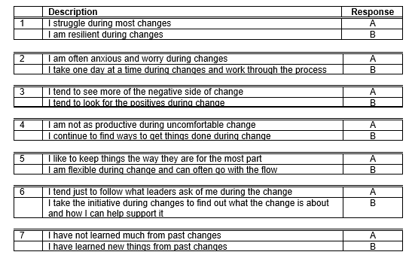
4. The Assessment
Fill in the assessment in your participant book.
Be honest with your assessment…you will be the only one to view it.
The answers will help you identify areas that, if developed well, will help you manage through change effectively.
Notes:
Slide Intent
Introduce the assessment.
Key Messages
Have participants fill in the assessment.
Discuss generally as a group without asking for specific responses.
You will use the results shortly in an exercise.
Facilitation Notes
The assessment helps them see areas they may need to address in their response to change. The content and discussions up to this point have provided insights on why change is so prevalent and the need for all employees to address change positively.

Slide 21

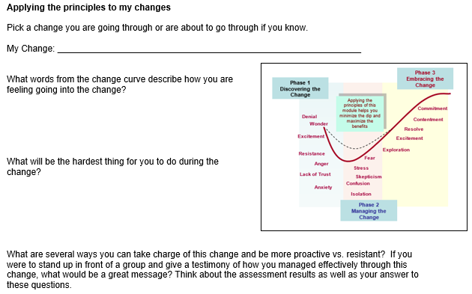
5. Personal Application
Pick a change you are going through now.
Fill in the answer for this exercise in your books.
Be prepared to discuss some insights you gain.
Notes:
Slide Intent
To help participants apply the principles of the module.
Key Messages
This exercise may have been accomplished during the change curve discussions and if so can be skipped here.
If it is additive, give participants several minutes to fill in the answers and then ask for some to share how they can apply what they have learned.
Facilitation Notes

Slide 22

6. Summary
Objectives Reviewed
Closing Thought
Review Actions
Dubai Change
Notes:
Slide Intent
Review identified action items to determine follow up steps.
Key Messages
If up identified action ideas during the session, review these to determine who will follow up with the next steps and by when.
Facilitation Notes
It is important to follow up on identified actions and suggestions from the group to maintain credibility and engagement from the participants.

Slide 23

Objectives Revisited
Discover how to proactively embrace and take charge of change
  Describe one insight you have now to help you embrace change.
Maximize the personal value of change
  List a value you have received from past changes?
Assess your approach to change
  What was your strongest change assessment approach?
  What is one opportunity you have for improvement?
Apply practical steps to navigate through change
  List one thing you will apply to better embrace change
Notes:
Slide Intent
Review objectives to see if they were met.
Key Messages
These objectives were outlined at the start of the module.
We added focus questions.
Ask participants to read through and pick one question in blue to answer.
Facilitation Notes
It is a good facilitation practice to review the objectives at the beginning and end of a session so participants know what to focus on through the session.
Most of the learning actually takes place after the session through application. Ensure there is an emphasis on how they will apply the skill. Ideally, there should be a follow up session to have them share their experiences.

Slide 24
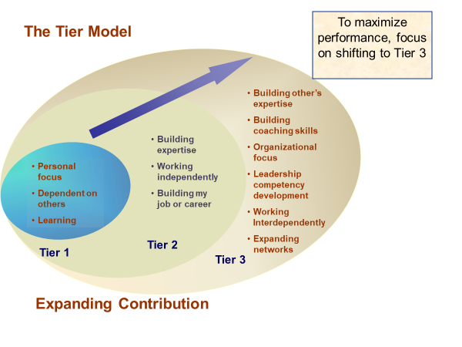
Closing Thought
How does Embracing Change help you shift towards the Tier 3 Characteristics?
Notes:
Slide Intent
Review of the module by asking for a learning from the participants.
Key Messages
Do a quick review of the Tier Model.
Responding to change per this module is a Tier 3 application.
See if the participants see why this is a Tier 3 approach and the value that has on personal growth, team growth, and business impact.
Facilitation Notes
By employees applying the principles of change in the way they work, they will be working more in the Tier 2 and Tier 3 characteristics. They will take charge of their approach to change. They will support others and coach others. They will focus on competency development that may prepare them for future roles.

Slide 25
Review Actions
What do we need to act on?
How will we proceed with what we identified?
Notes:
Slide Intent
Review identified action items to determine follow up steps.
Key Messages
If up identified action ideas during the session, review these to determine who will follow up with the next steps and by when.
Facilitation Notes
It is important to follow up on identified actions and suggestions from the group to maintain credibility and engagement from the participants.

Slide 26

In Times of Ambiguity
Do what you can with what you have where you are
Do not let what you cannot do stop you from doing what you can do
Do not wait for the storm to pass…learn to dance the rain

Slide 27
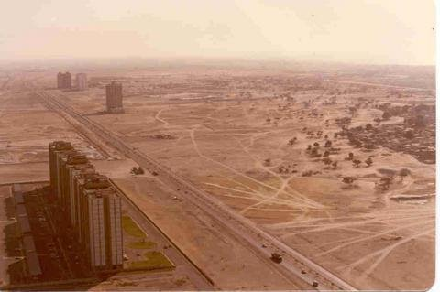
The Need for Change
Dubai 1990
Notes:
27
This is the city of Dubai in 1990.

Slide 28

The Need for Change
Dubai today
Notes:
Dubai in 2010 Dubai took charge of pending changes. They realized that their main income source of oil would run within 20 years so they figured out other ways to stay viable vs. turn into a ghost town. They shifted resources toward tourism.
Many ghost towns today are the result of focusing only on the present vs. planning for the future.

